Slide 1
N-Gram Language Models in Modern NLP
Group 21 – Literature Survey Presentation
Member: Shaojie Zhang

Slide 2
Abstract
We survey the evolution of N-gram language models, their continued role in NLP, and their hybrid integration with neural models. Five recent papers were analyzed to extract key trends and findings.

Slide 3

Introduction
• N-gram models predict word sequences based on statistical frequency.
• Historically used in translation, ASR, and spelling correction.
• Still useful in low-resource or interpretable contexts.

Slide 4
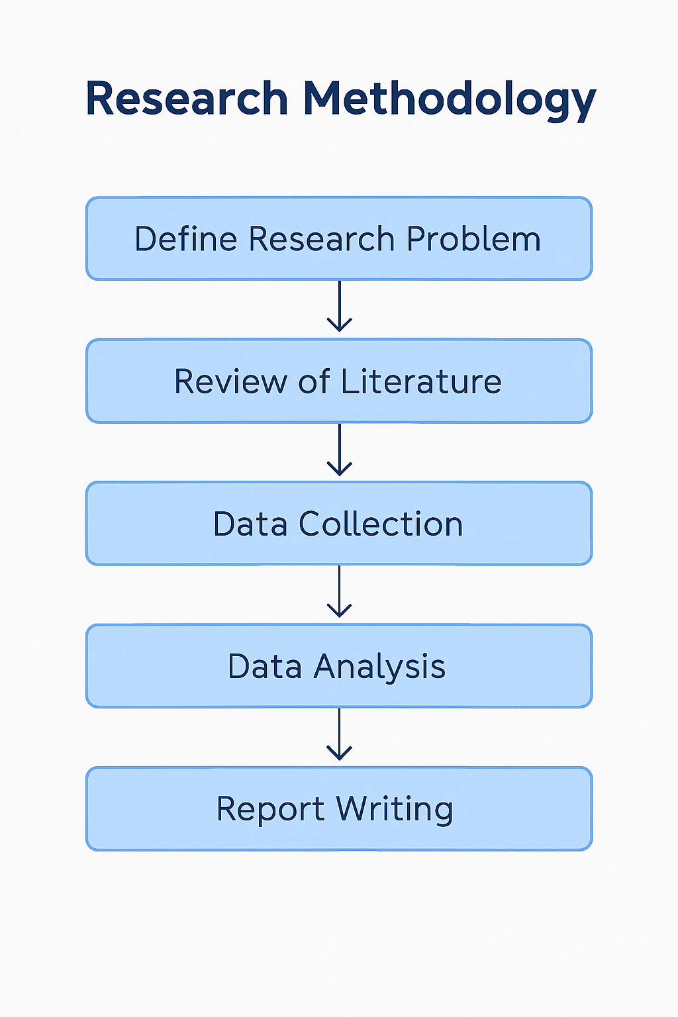
Methodology
• Sources: IEEE Xplore, arXiv, Google Scholar
• Keywords: 'n-gram language model', 'hybrid NLP models'
• Selection: Recent, highly cited papers from past 5 years

Slide 5
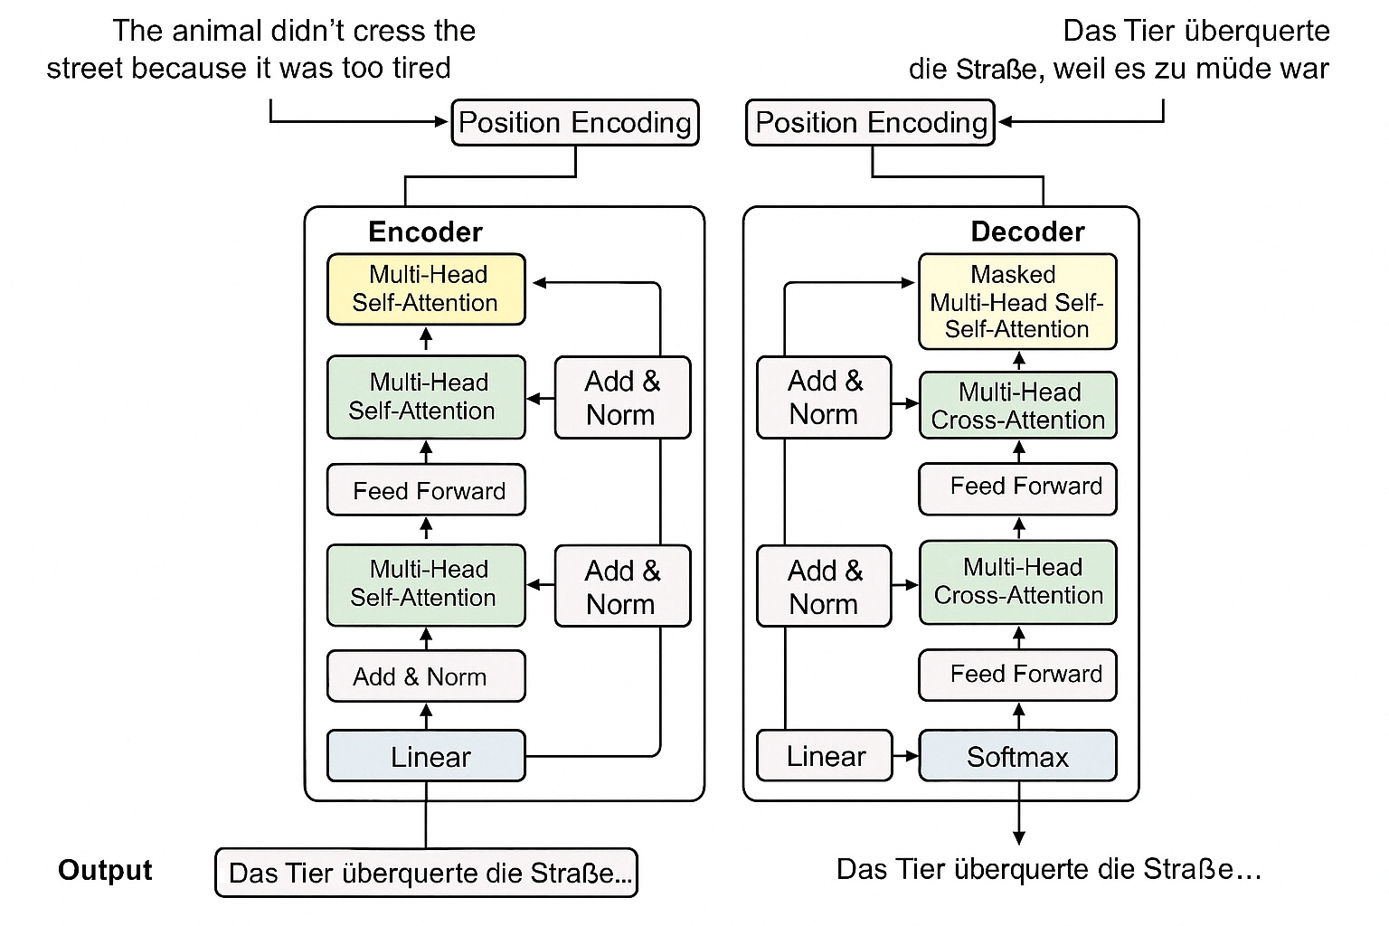
Literature Review – Thematic Analysis
• N-Grammer: N-grams + Transformers
• Infini-Gram: Trillion-token scale N-gram
• ERNIE-Gram: Phrase-level masking
• N-Gram Is Back: Residual learning with N-grams

Slide 6
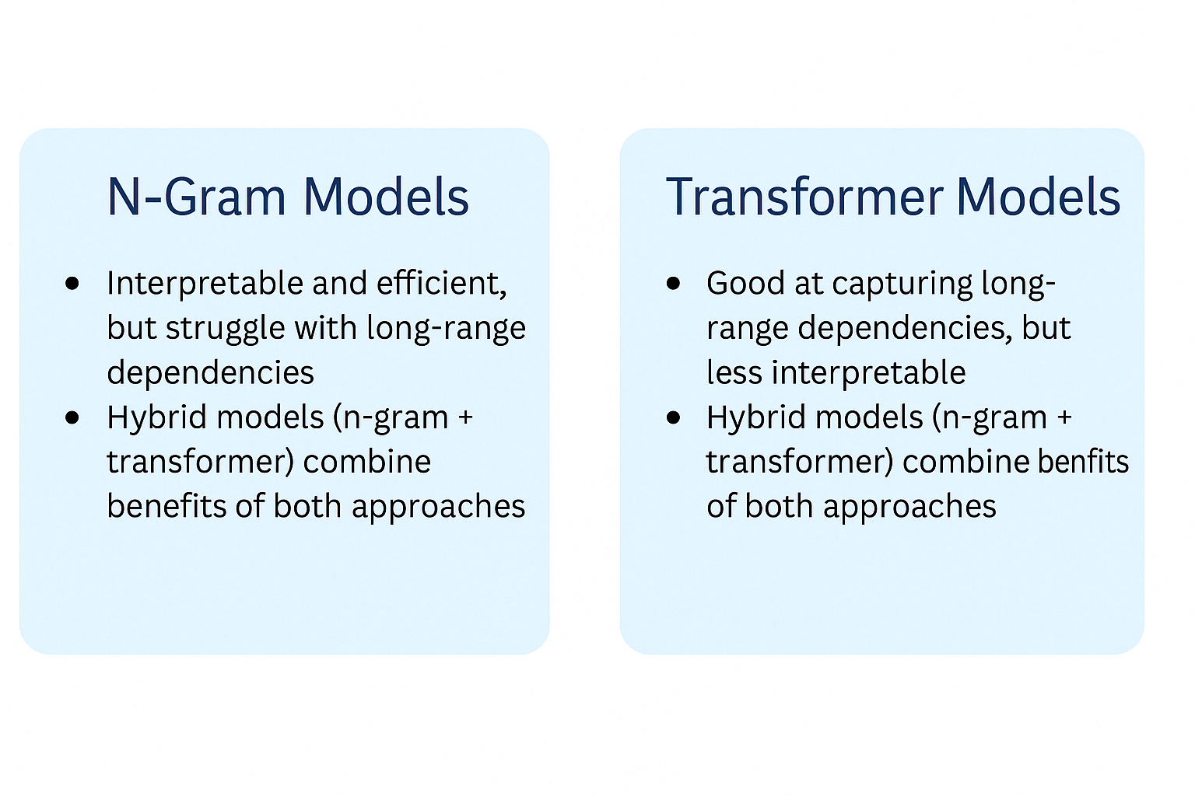
Literature Review – Comparative Analysis
• Pros: Interpretable, efficient, fast
• Cons: Weak at long dependencies
• Hybrids improve classification and generation tasks

Slide 7
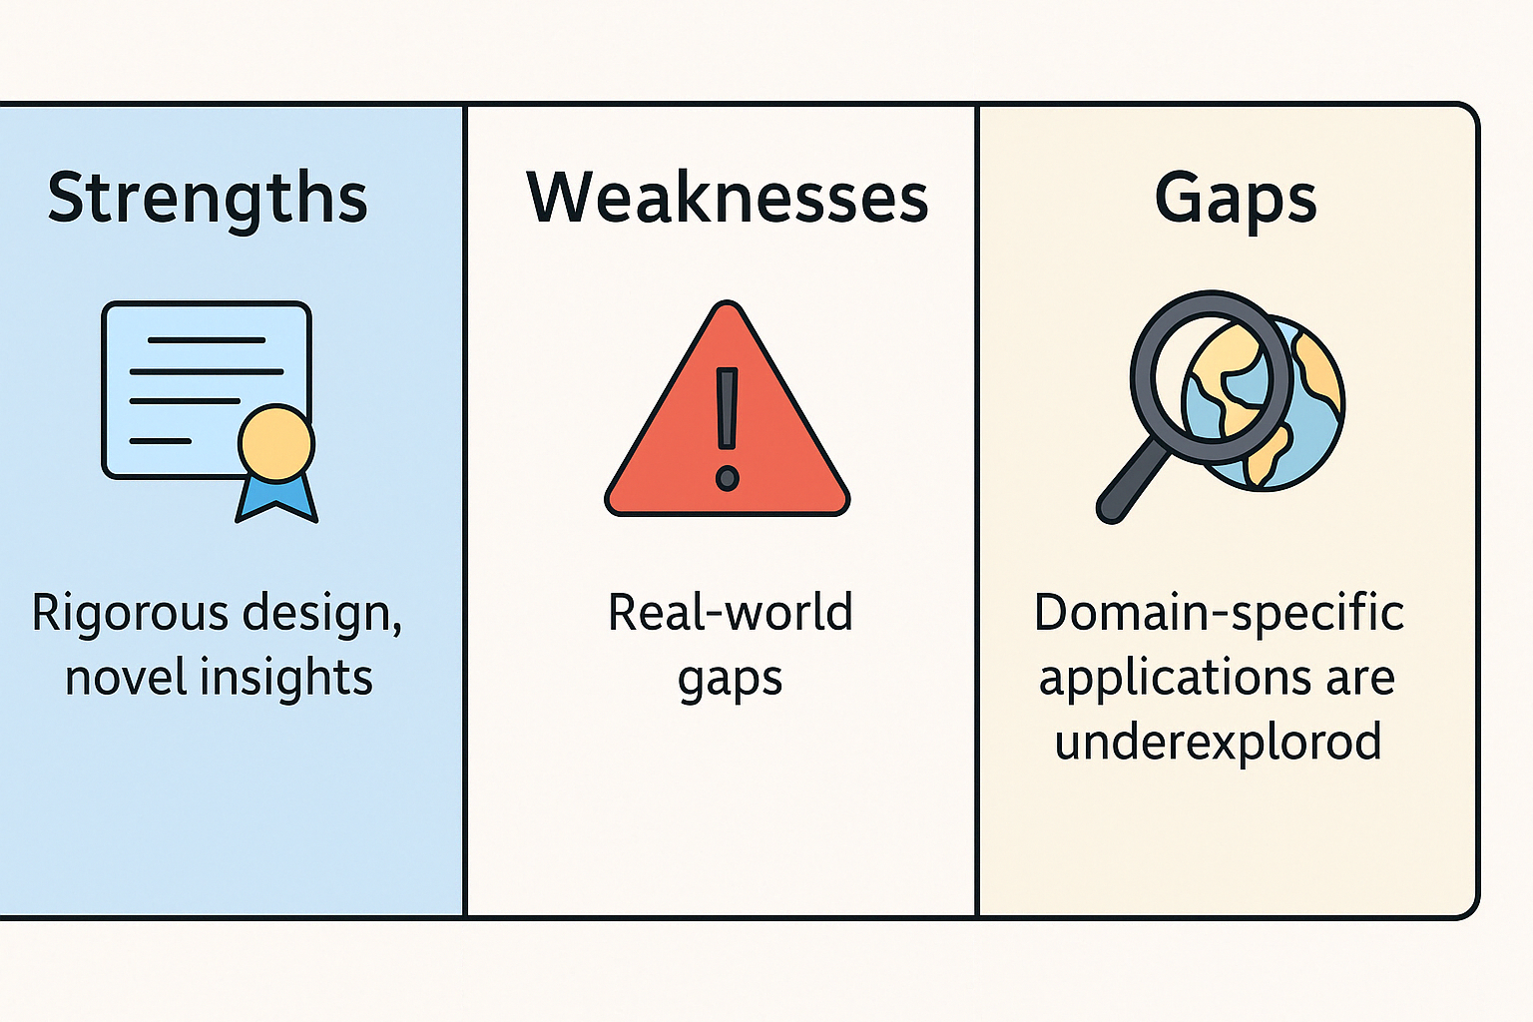
Critical Analysis
• Strengths: Rigorous design, novel insights
• Weaknesses: Real-world gaps
• Gaps: Domain-specific applications are underexplored

Slide 8
Conclusion & Future Work
• N-gram models remain relevant in modern NLP
• Hybrid models enhance performance
• Explore domain adaptation and optimization

Slide 9
Q&A
Thank you for your attention!
We welcome any questions.

